Slide 1

Protein information in live cells: quantitative bio-imaging
Sylvain Tollis, Institute of Biomedicine, University of Eastern Finland
Summer School in Computational Proteomics 2021, August 9th , 1.30pm CET

Slide 2
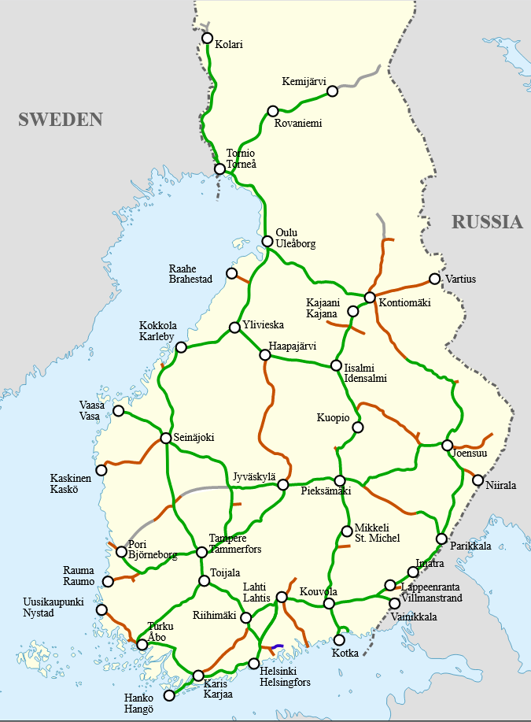
Introduction
Biological network:
High-throughput proteomics identify components (“who”, nodes)
Biochemical/cell biological exps identify functions (“who does what”, network connections)
Network parameters:
Where? When? How much?
Complex biological function = travel from one node to another
https://github.com/oercompbiomed/CBM101/tree/master/A_Introduction
Need to know train departure times, speed, station opening times, regional networks, train size vs # booked seats …
Measure protein dynamical parameters in live cells: proteins #, localization, diffusion/transport, interactions, … etc.

Slide 3
« Standard » fluorescence microscopy
Fluorescence microscopy:
excite particular molecules (fluorophores) with laser, measure light emitted.
Laser excitation
Protein localization, relative quantification, co-localization, response to stress … etc in real time and live cells/tissues
GFP
Protein 1
Emitted light
(fluorescence)
mCherry
Protein 2
Laser excitation
Autofluo molecule
Improved contrast with confocal conditions or 2p excitation
(δz->0)
Limitations:
GFP
Protein 1
cellular autofluorescence, off-z light
Diffraction limit d=λ/(2*NA); PSF
Relative, but not absolute protein counts
Autofluo molecule
Autofluo molecule
Laser excitation
GFP
GFP
d≈200nm
Overlapping signals

Slide 4
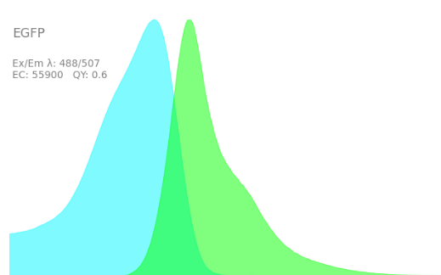
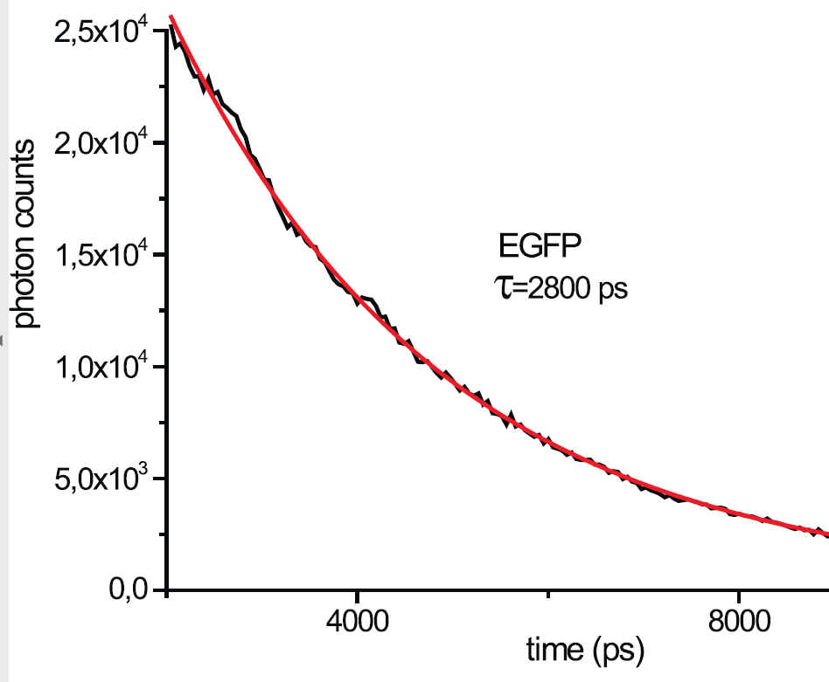
Taking a step back: the dark depths of fluorescence
Fluorescence process:
3 steps: absorption, relaxation, fluorescence emission
GFP energy
GFP
Emitted
photon
Laser photon
Fluorophore characteristics (exploitable):
Absorption/emission spectra (here, eGFP, source: fpbase.org)
Fluorophore brightness: b=# photons emitted /sec/molecule = # photons absorbed /sec/molecule (termed ”extinction coefficient”) * probability emission (termed ”quantum yield”). Depends on pH, chemical environment, laser power…
Fluorescence lifetime: timelag δt between
absorption and emission with probability
P=exp(- δt/τ); τ=fluo. lifetime, depends on chemical
environment (e.g. O2), pH, protein interactions…
Ab/Em probability
400
500
600
wavelength
From Mamontova et al., Sci. Rep. 2018

Slide 5
How to measure and use these parameters? Instrumental requirements
Image with scanning confocal microscope with fast scanner
Accurately control spectra with adequate optical filters
Detect single photons
Measure their emission time with respect to femtosecond exciting laser pulses;
Pixel dwell time
fs
δt₁
δt₂
Laser pulse
Photon#1
detected
Photon#2
detected
Time
Accumulate photon time data over repeated pulses during ~40μs (pix dwell time)
Save single photon data with ultra-fast electronics (<0.1ns response time, e.g. TCSPC, FLIMbox…)
Use custom analysis software to remove electronics noise, autofluorescence… depending on application

Slide 6
Count molecules and get absolute concentration maps in single live cells:
(Scanning) Number and Brightness (sN&B)

Slide 7
sN&B
Mean pixel intensity (# photons/dwell time): F=n*e
Pixel intensity variance: σ=n*e²+n*e e=σ/F-1, n=F/e, at each pixel
e_{dimer}=2*e_{monomer}, so s=e/e_{monomer} and n_{proteins}=F/ e_{monomer}, e_{monomer} from cells expressing the monomeric fluorophore “free” of protein binding
Protein-GFP fusion
From Dorsey*, Tollis*, et al., Cell Systems 2018
Free monomeric GFP
Repeated sample scans yield ”maps” of tagged proteins number n_{proteins} (concentration) and stoichiometry s (oligomerization/clustering)

Slide 8
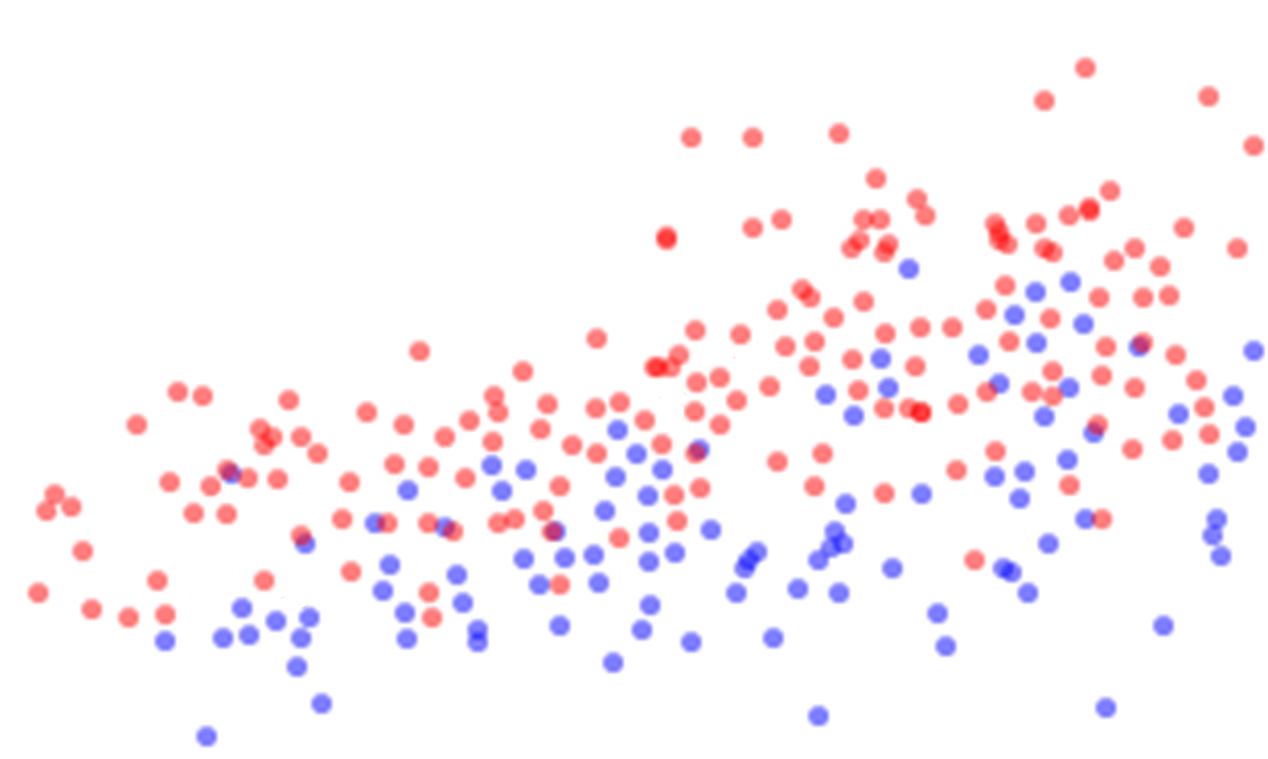
Example of sN&B data: G1/S transcription factors in yeast (TF)
TF-GFP
150
1.5
From Dorsey*, Tollis*, et al., Cell Systems 2018
100
TF to G1/S promoters ratio Glu Gly
[TF] (nM) Glu Gly
1.0
50
0.5
Size = 10fL
30fL
Birth G1 growth G1/S G1/S
1 dot = 1 cell
Measure nuclear TF concentration in individual G1 cells; correlate with cell size
TF copy number << # G1/S promoters in small cells: no G1/S transition
TF concentration and nuclear size increase in G1: progressive G1/S promoter saturation allowing cell cycle commitment
Elevated TF conc. in poor carbon (glycerol); G1/S at smaller size; mechanism couples cell size to nutrients availability

Slide 9
Compute diffusion coefficients with subcellular resolution:
Raster Image Correlation Spectroscopy (RICS)
Notes:
- quantitative imaging and mathematical modeling complement high throughput

Slide 10
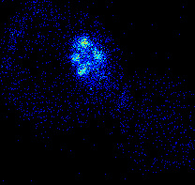
RICS
Laser scans horizontal line, stays 20-60μs / pix (dwell time τ), gets back to original position, scans next line.
Shift between exact imaging time of neighbor pixels: ≈ 100’s μs along horizontal, ≈ few ms along vertical.
Compute < F_{k},^{j+δj}- F_{k},^{j+δj} >_{k,j} (horizontal pixel shift δj) and < F_{k},^{i+δi}- F_{k},^{i+δi} >_{k,j} (vertical pixel shift δi);
Example data: RICS correlations for condensin in WT vs cdc48/p97/VCP mutant
(NLS-GFP: free diffusion control)
H-correls (multiple cells, mean/ste)
V-correls (multiple cells, mean/ste)

Slide 11
Fitting data with motion models (e.g. SIMFCS): allows to measure protein mobility (diffusion coefficient) with single live cell (even sub-cellular) resolution
With adequate controls, RICS probes binding/free diffusion (in particular, to DNA)
cdc48-3 (metaphase)
WT (metaphase)
Pre-post metaphase cells (WT and cdc48-3 are similar)
Occurrence (% of scored cells)
From Thattikota et al., Mol. Cell 2018
Diffusion coefficient (μm²/s, averaged over each individual nucleus + perinuclear region)
Slower condensin mobility in cdc48/p97/VCP-defective mutant:
cdc48/p97/VCP promotes condensin recycling to/from DNA

Slide 12
Fluorescence Lifetime Imaging (FLIM)
Pixel dwell time
fs
δt₁
δt₂
Laser pulse
Photon#1
detected
Photon#2
detected
Time
Notes:
- quantitative imaging and mathematical modeling complement high throughput

Slide 13
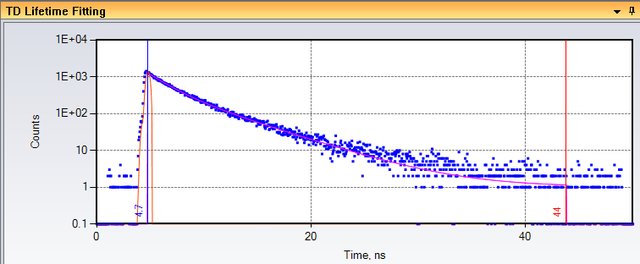
FLIM
Record emission time for each photon: reconstruct fluorescence decay curves
fs
δt₁
δt₂
Laser pulse
Photon#1
detected
Photon#2
detected
Time
Emission time, nanoseconds
Decay time τ characteristic of each fluorophore: fit to exponential decay, obtain τ
Fluo. lifetime insensitive to spectral filter effects, static quenching or variations in the fluorophore concentration: robust parameter
Real-life = mix of multiple components
Perform sine & cosine Fourier transforms of decay curve and get 2 numbers at each pixel
Represent each pixel in 2D with these numbers (“Phasor plots”)

Slide 14
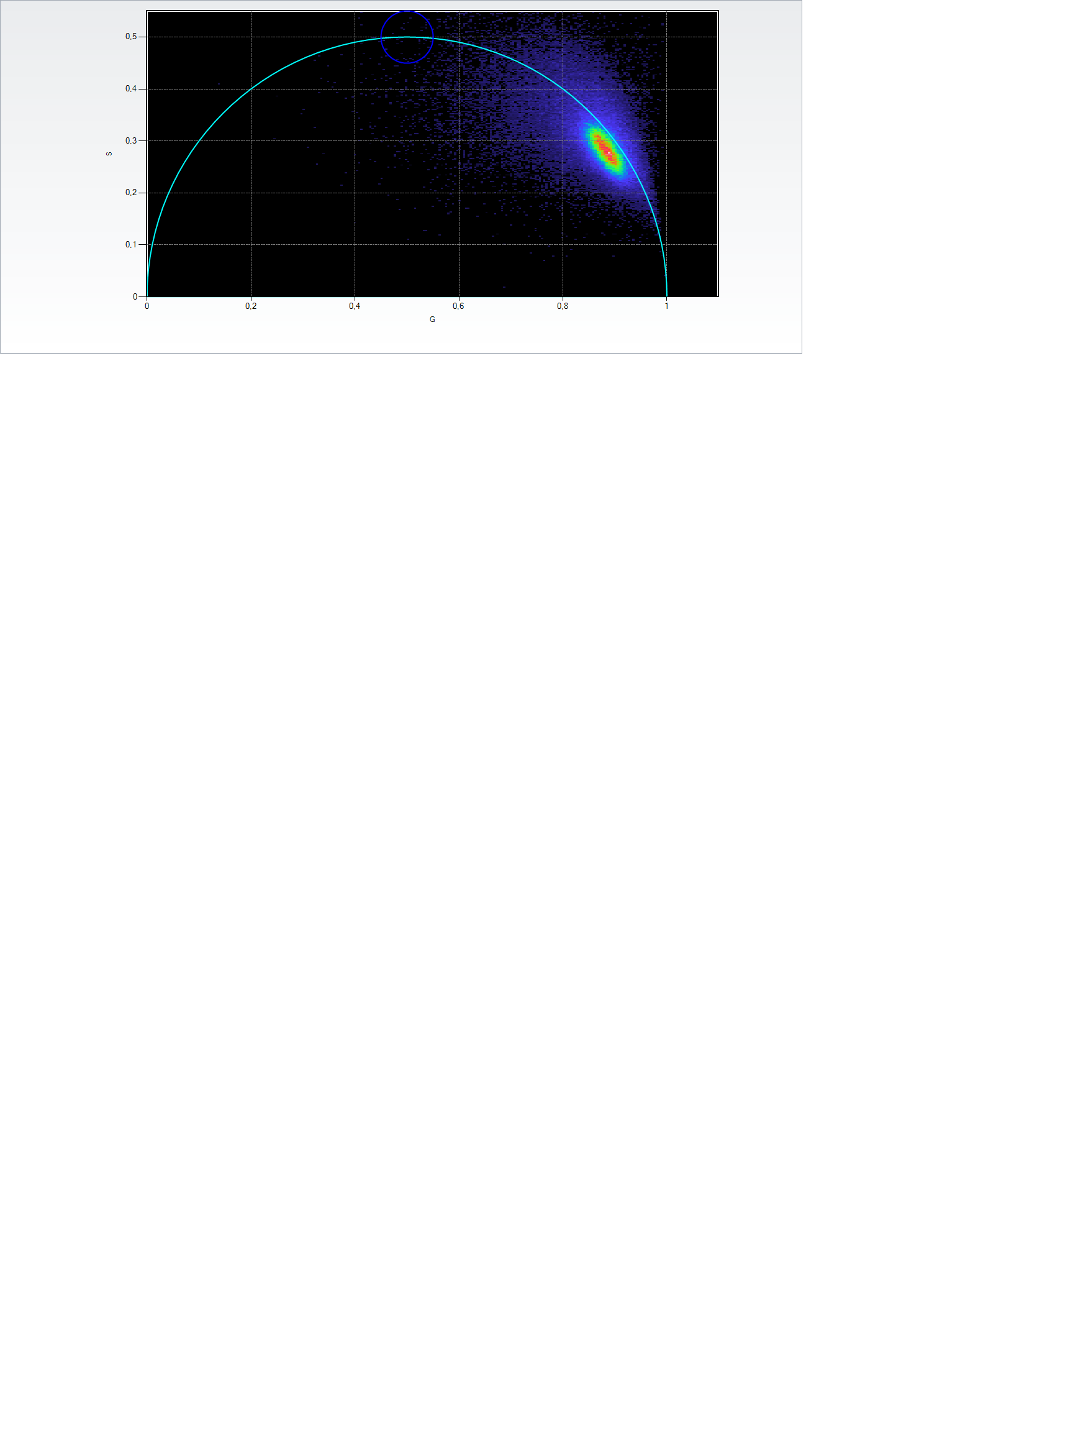
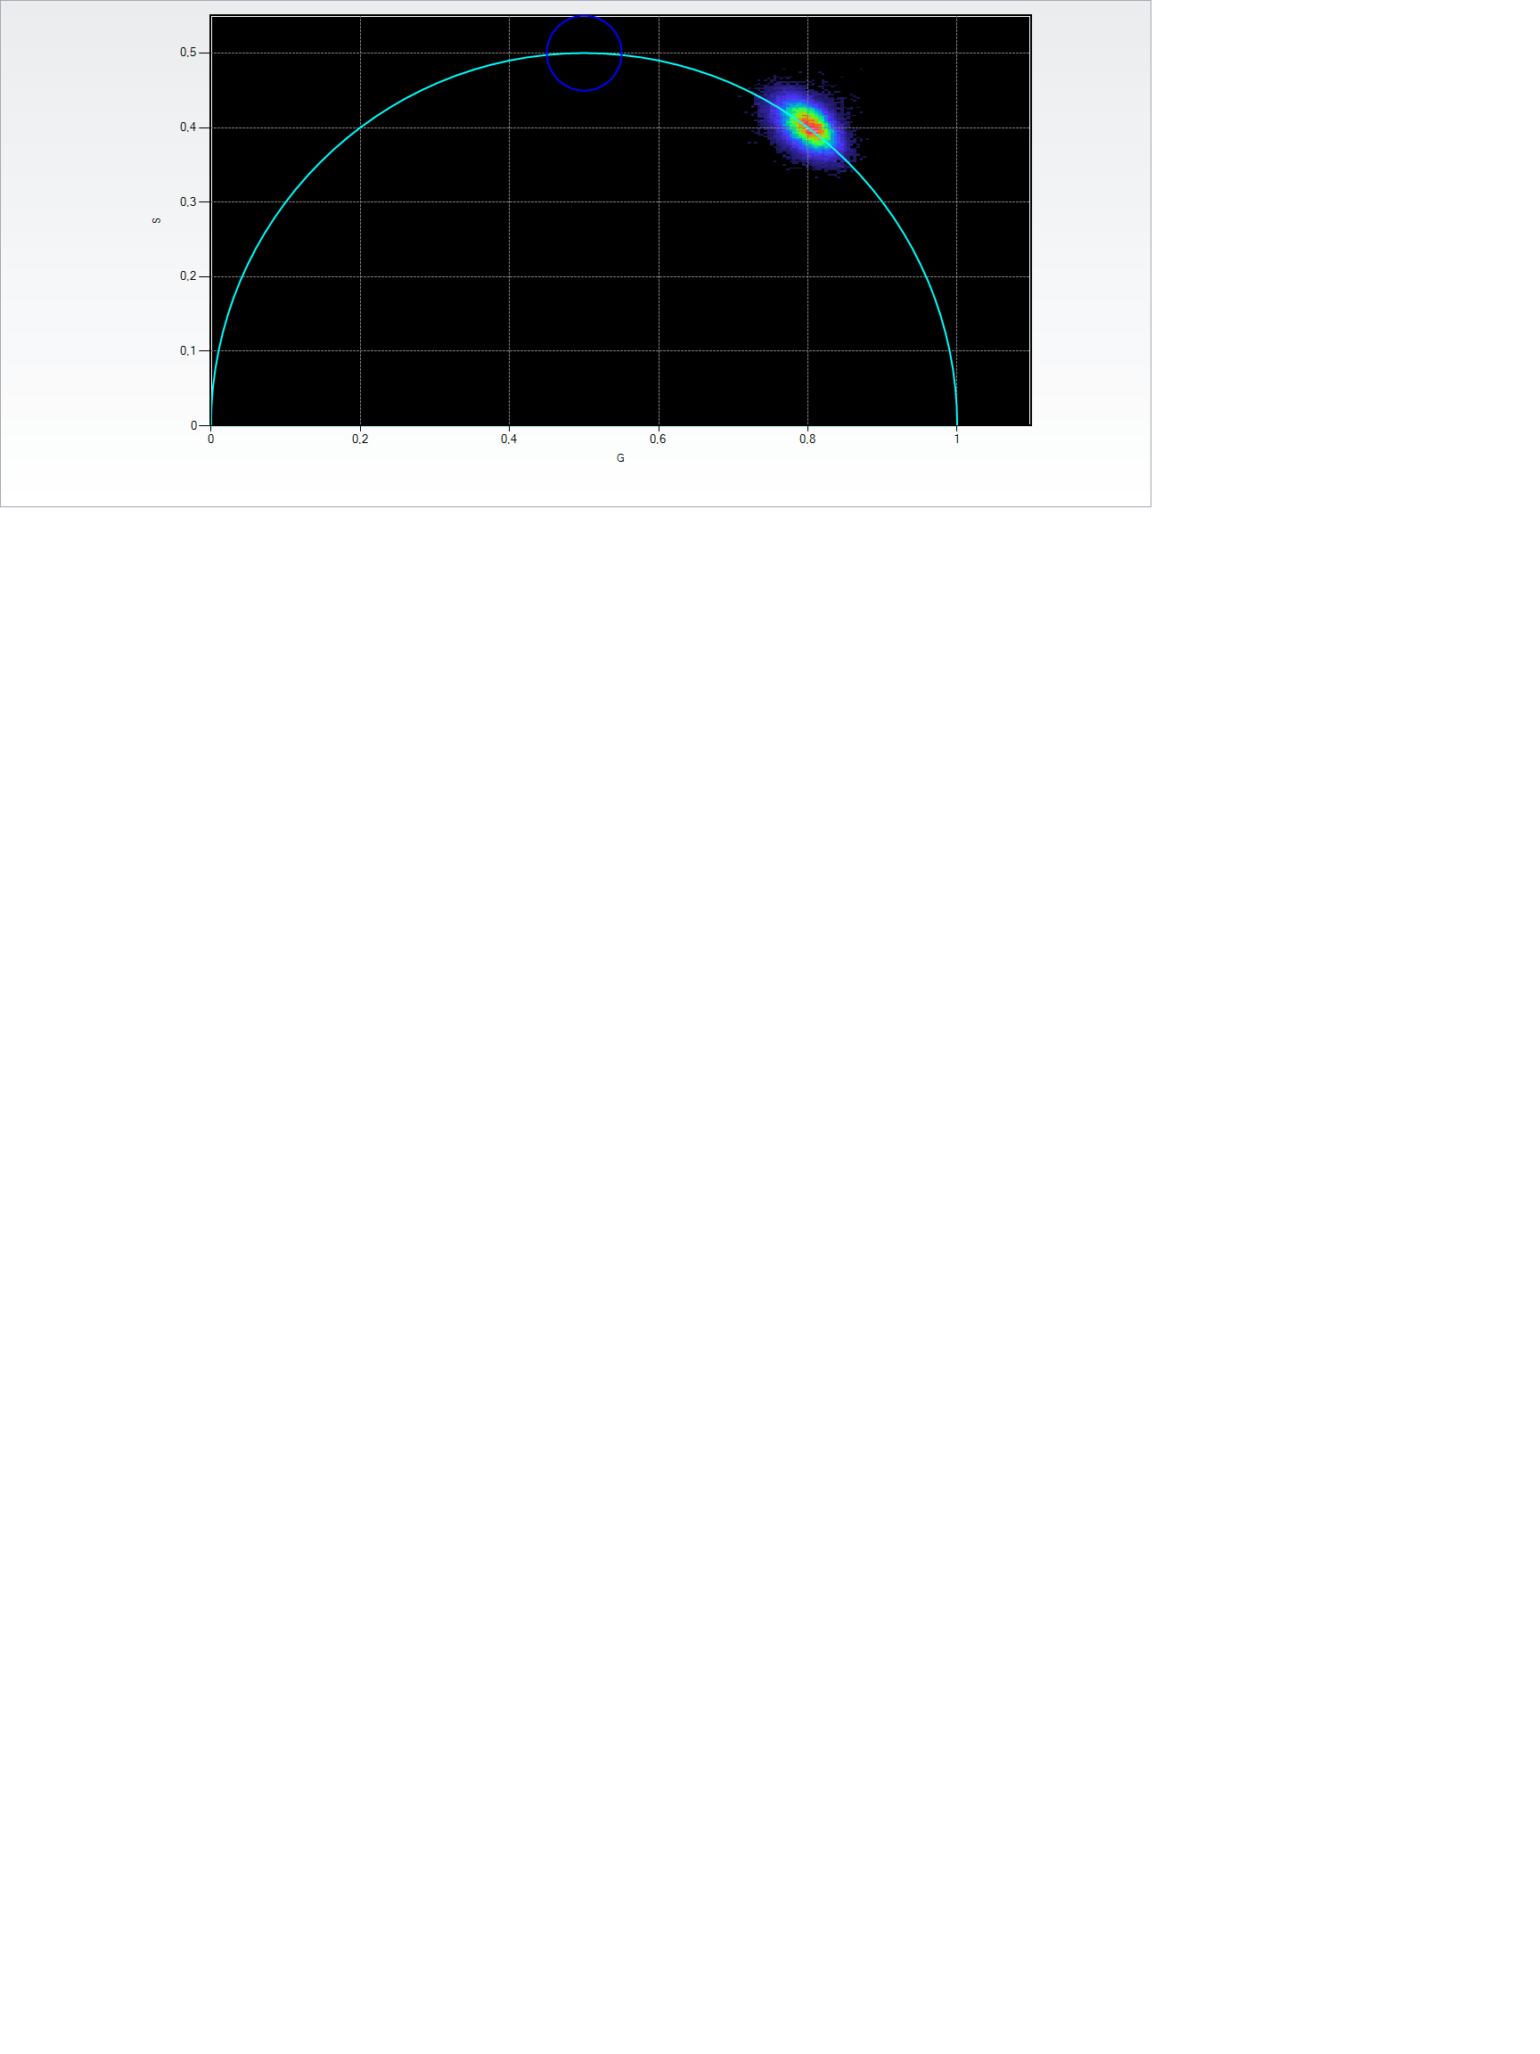
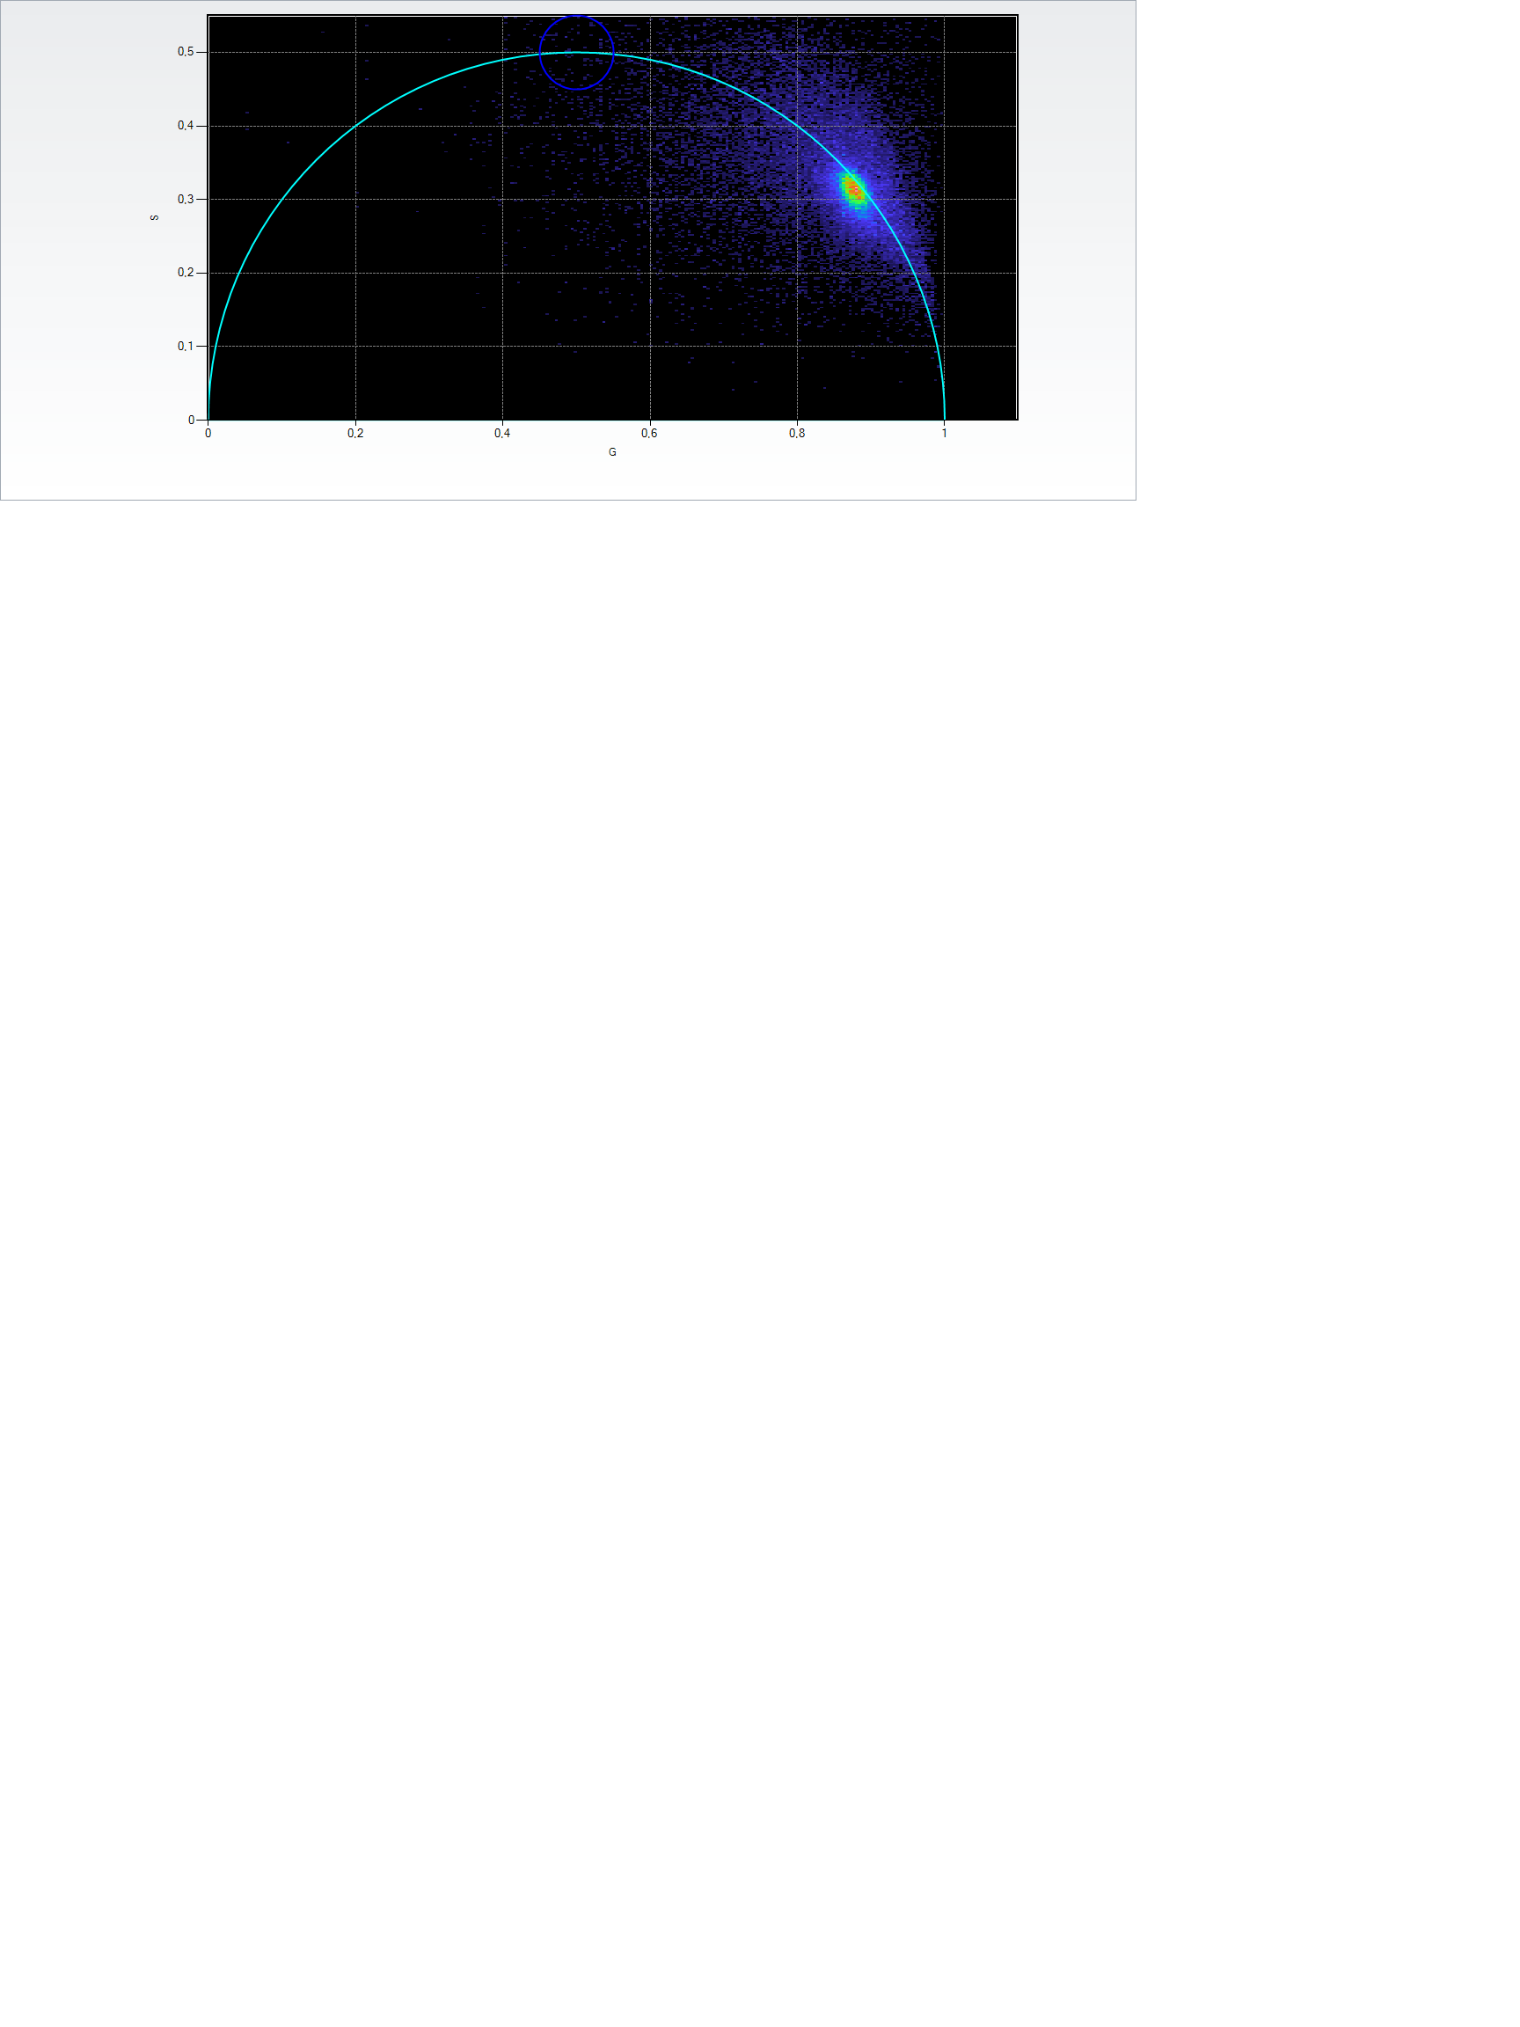
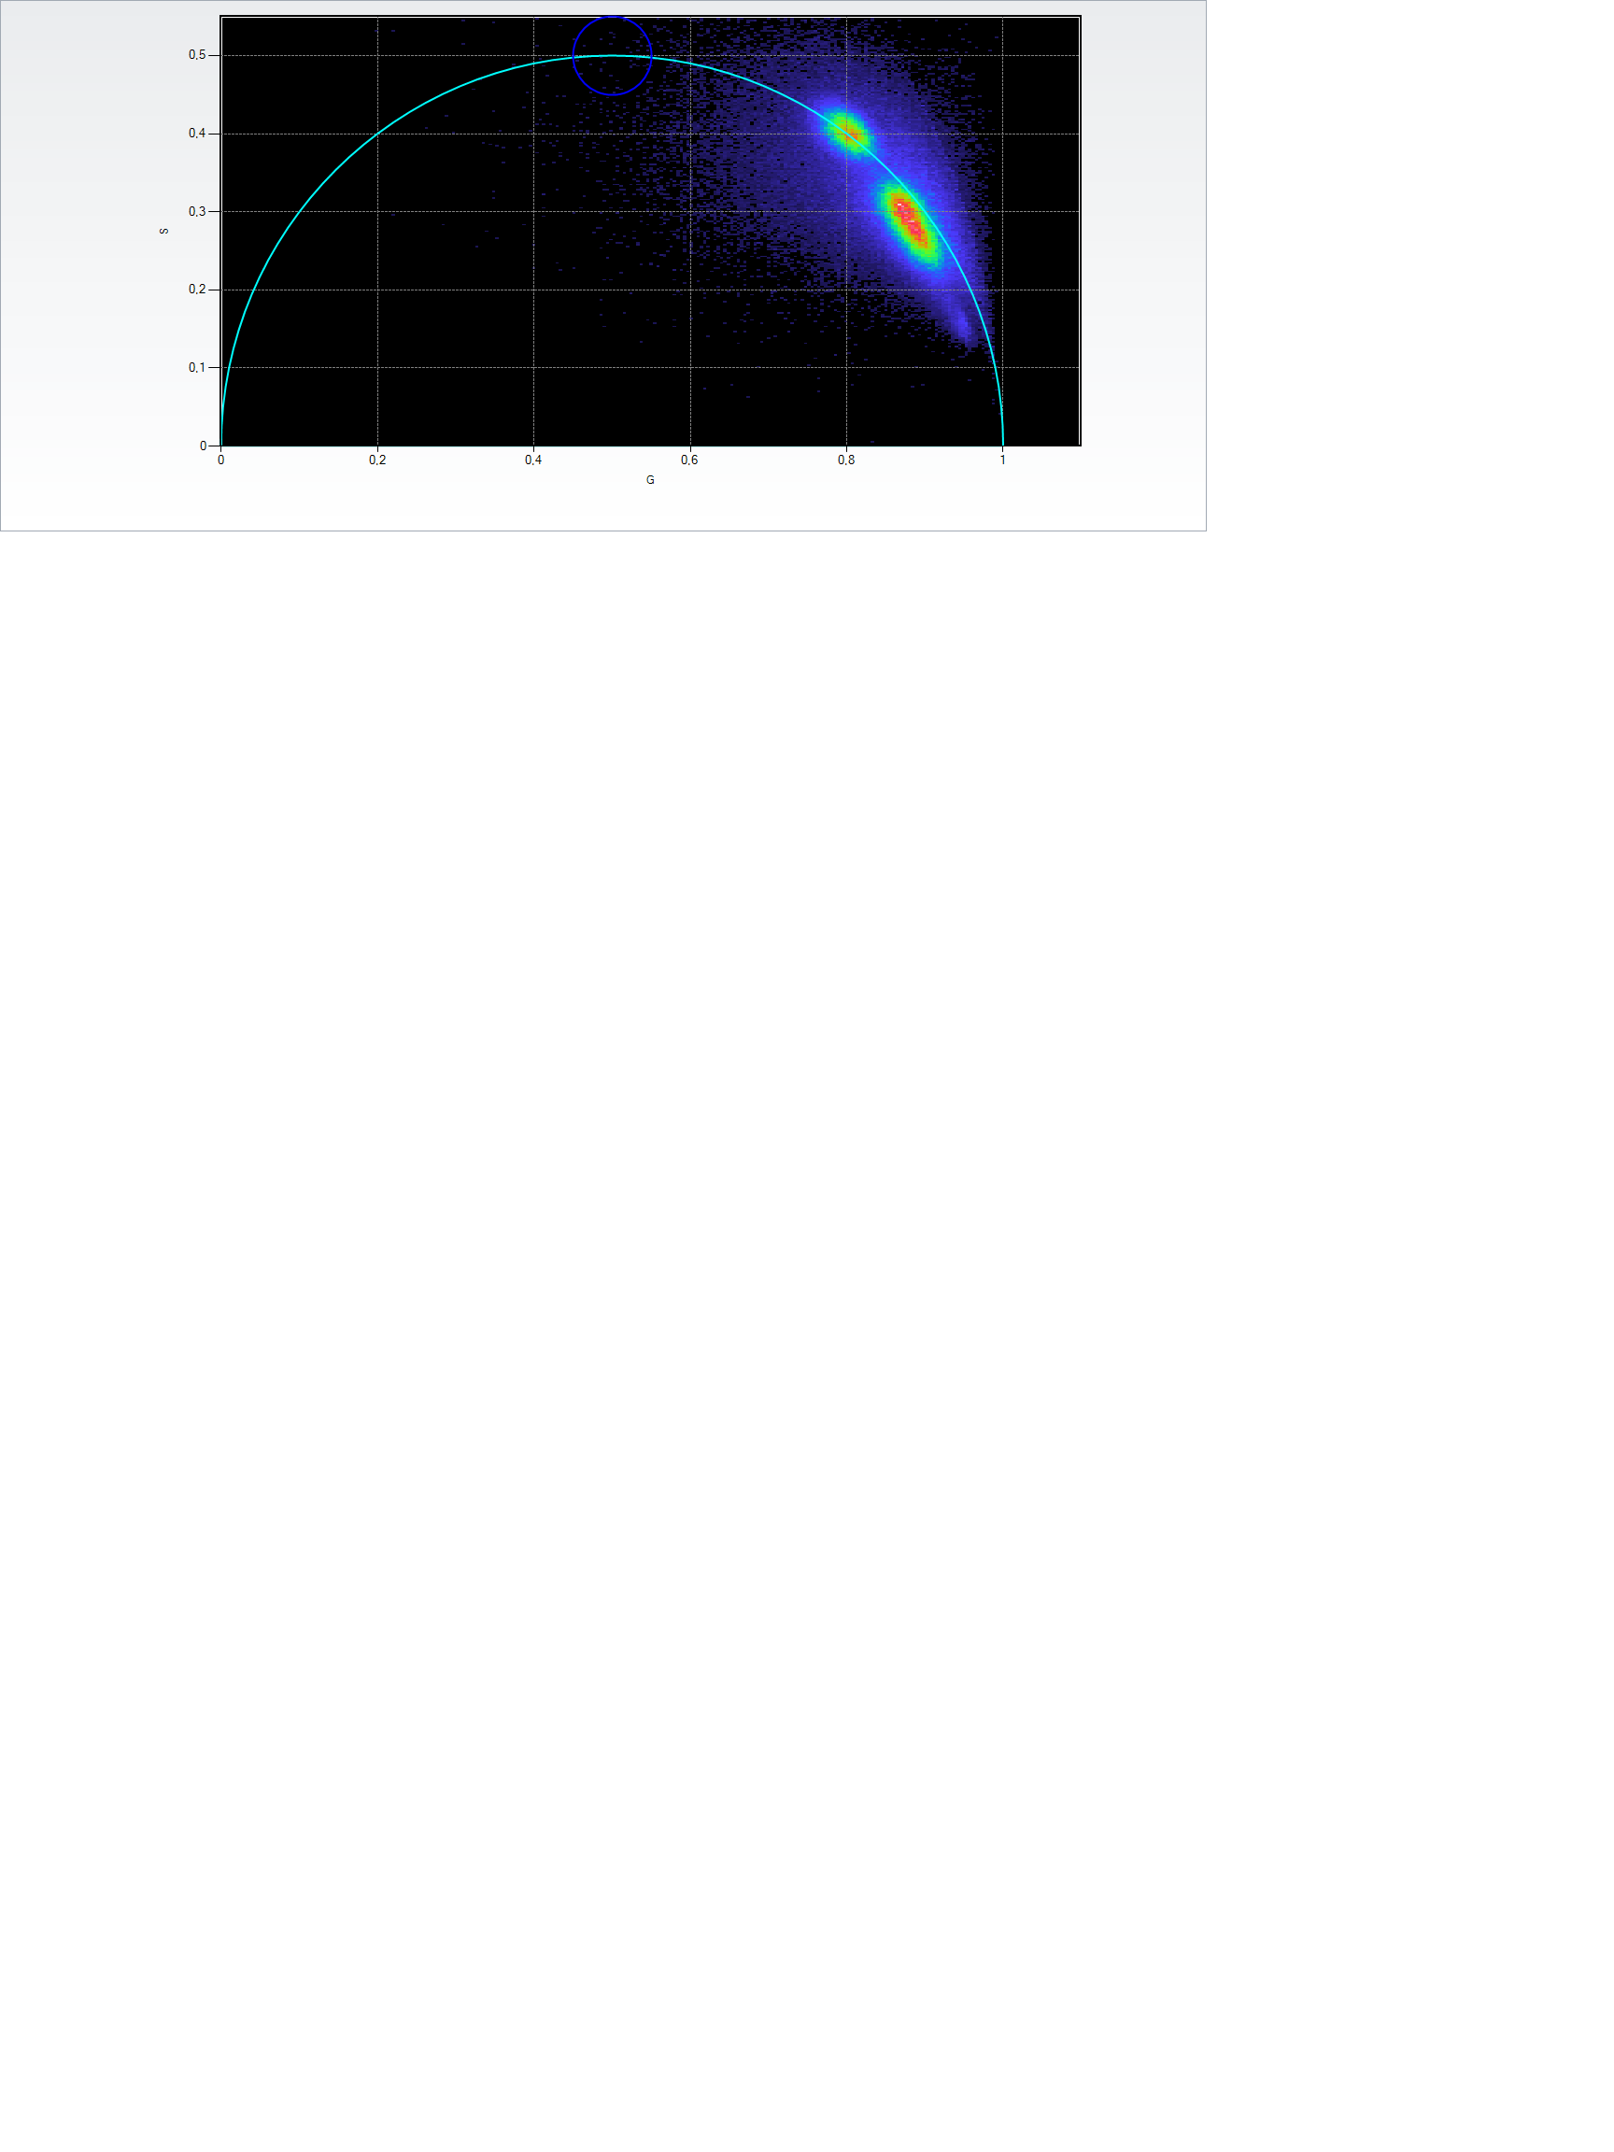
Illustration: different species emitting green fluorescence (live S. pombe cells)
Untagged, WT S.pombe cells
Fluorescein in solution
Fluorescein
mNeonGreen
Autofluorescence
Mst2-mNeonGreen S.pombe cells
Combining all samples
Different fluorescence sources have different lifetimes
Autofluorescence: generally broad “spot”, mixing short and large lifetimes
Fluorophores (dyes or proteins fusions): generally focused spot at a specific position on the circle (from right to left: short to long lifetimes, mNeonGreen=2.8-3ns, fluorescein=4ns)

Slide 15
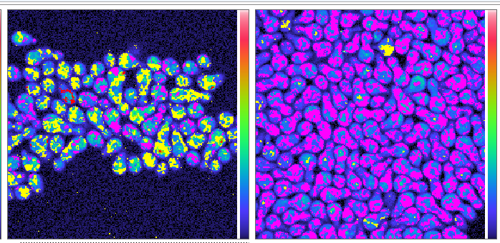
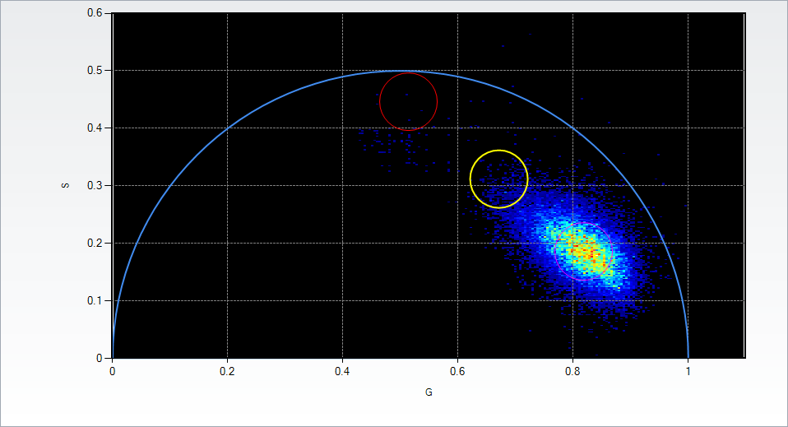
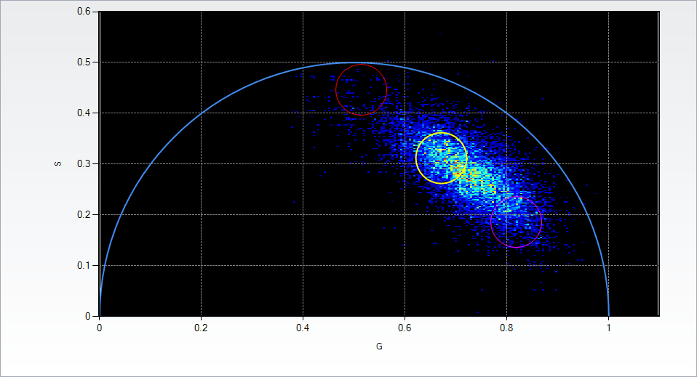
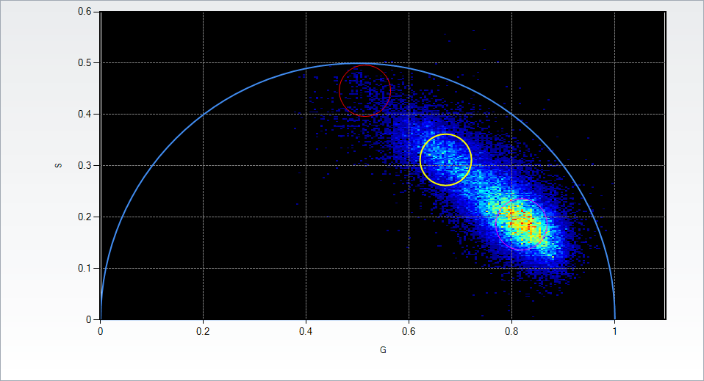
Example: the Cln3 G1 cyclin, a ghost inside yeasts
Courtesy of Cathy Royer, RPI
Autofluorescent cells
Whi5-GFP
Cln3-GFP cells
Autofluorescent cells
Cln3-GFP cells
Red=pure GFP
Pixels with a mix of 2 fluo. sources are not on the circle but along the chord of the circle arc joining the 2 spots
The relative position on the chord depends on the mix composition
GFP signal not above autofluo can be resolved by FLIM
Yellow =
Autofluo+GFP
Pink = pure
Autofluo

Slide 16
Probe protein chemical neighborhood with FLIM
Notes:
- quantitative imaging and mathematical modeling complement high throughput

Slide 17
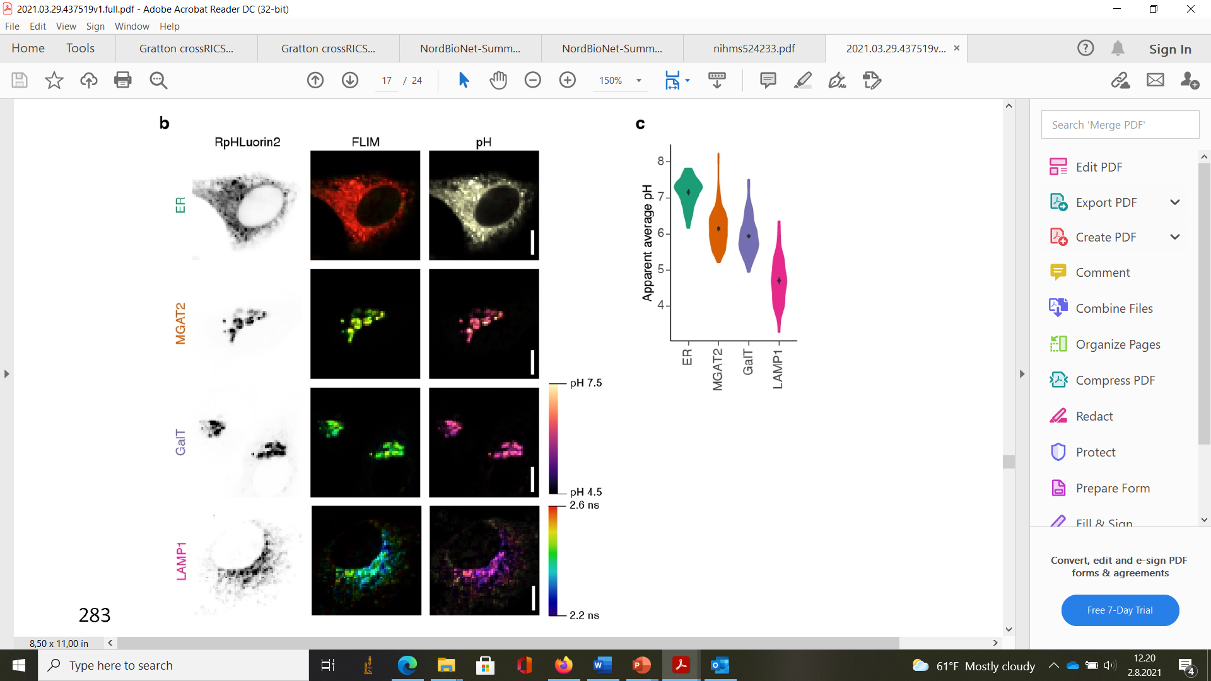
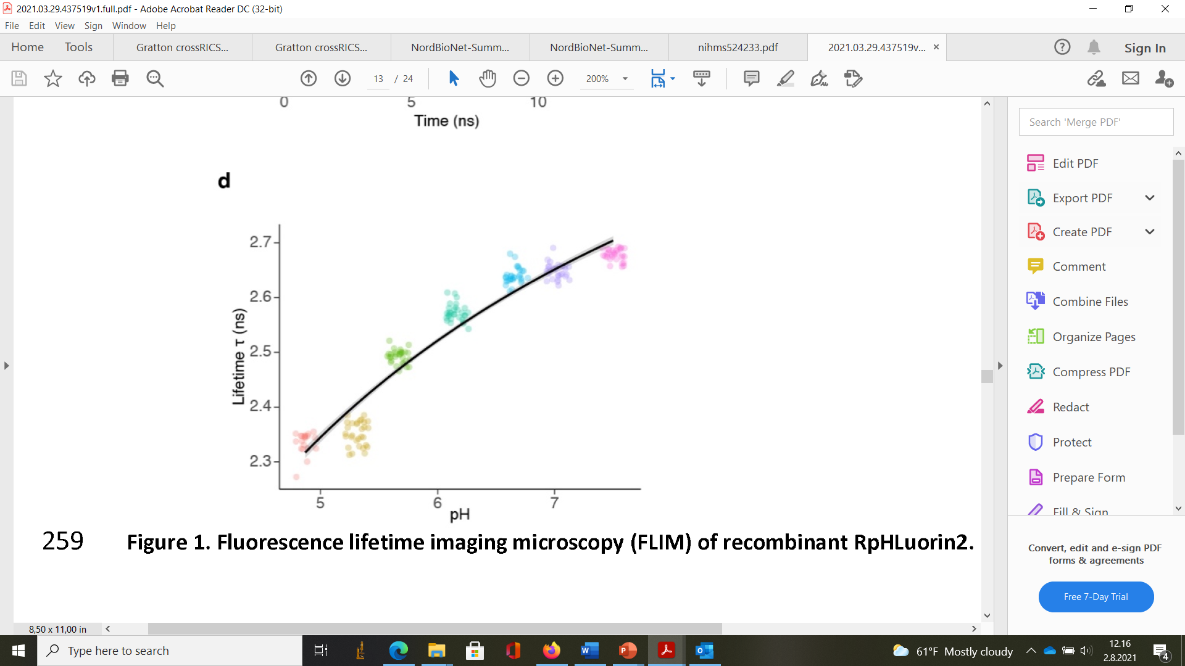
For a given fluorophore, lifetime/phasor spot position influenced by chemical neighborhood
FLIM senses pH, ion or oxygen concentration, molecular binding ….
RpHLuorin2 fused to secretory compartment markers
Calibration: RpHLuorin2 lifetime in pH buffers
ER
From Linders et al., BioRxiv 2021
cis-Golgi
trans-Golgi
pHLuorin2=GFP optimized for pH sensing
Lifetime vs pH calibration data in buffers
Fused to different markers along the secretory pathway in HeLa cells
Lysosomes
Map pH in cellulo at subcellular scale

Slide 18
Quantify protein interactions: FRET-FLIM
Notes:
- quantitative imaging and mathematical modeling complement high throughput

Slide 19
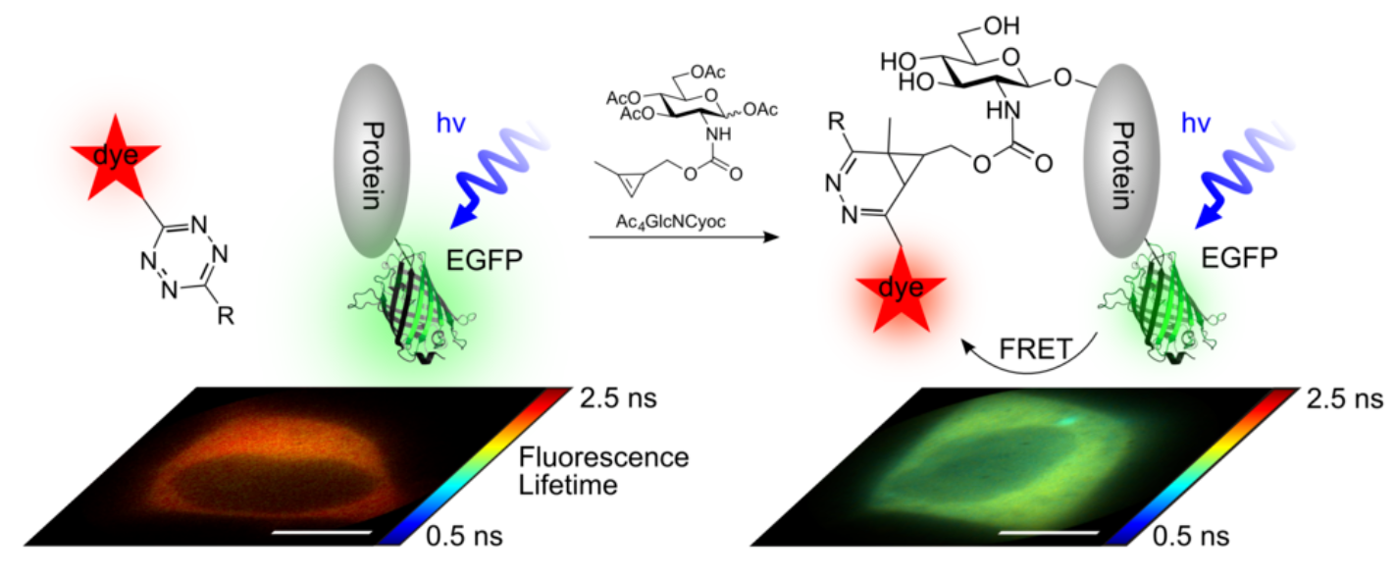
FRET (Förster resonance energy transfer) = loss of fluorescence brightness due to short range (1-10nm) molecular interactions of the fluorophore molecule
Pair of fluorophores: FRET donor/acceptor; decreased lifetime of FRET donor
Example: use FRET-FLIM to detect PTMs (e.g. glycosylation-reporter here)
From Doll et al., Angew Chem. Int. Ed. 2016
(yellow-red) dye-conjugated post-translationally added group binds GFP-tagged protein under PTM-favorable conditions
GFP energy relaxes to dye (FRET acceptor): GFP lifetime drops
Possible to compute fractions of clean/PTM protein with lifetime shift
Possible to monitor 2-protein binding, or 1-protein conformational changes the same way

Slide 20
Conclusion: quantitative bio-imaging, a versatile toolbox to complement -omics data
Notes:
- quantitative imaging and mathematical modeling complement high throughput

Slide 21
Conclusion: take home message(s) (*): see Supp. Slides + lecture notes on Github
Why?
Quantitative parameters are crucial to understand complex systems - proteins/RNA/DNA constituents are only half of the story!
What to measure and how?
Proteins-mRNAs*, measure concentrations, and oligomerization/clustering: sN&B
Quantify protein-mRNA motion, measure diffusion coefficients: RICS, FRAP-FLIM*
Quantify protein synthesis: FRAP-FLIM*
Quantify protein-protein interactions: crossN&B*, FRET-FLIM
Quantify PTMs and conformational changes: FRET-FLIM
See the invisible (low expression, spectral overlaps): FLIM
Probe chemical properties of cellular compartments: FLIM+probes development
Technical constraints/aspects
Fluorophores: photostable, fast-folding, bright, monomeric, spectrally adjusted
Microscope: fast laser scanning, time-correlated single photon counting, fast detection electronics, controlled confocal volume
Samples: immobile & healthy live cells, autofluo. minimized and subtracted
And now?
Unbriddle your imagination to develop more techniques/probes!
In-depth course material to come on OERCompBioMed: stay tuned!

Slide 22
Supplementary Slides
Notes:
- quantitative imaging and mathematical modeling complement high throughput

Slide 23
Supp slide #1: counting mRNA with sN&B coupled to stem-loop RNA tagging systems
Notes:
- quantitative imaging and mathematical modeling complement high throughput

Slide 24

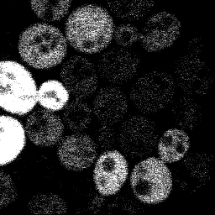
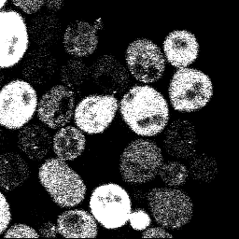
Counting also mRNAs: sN&B coupled to stem-loop RNA labeling
Whi5-12xPP7 stem loop
+no plasmid
Whi5-12xPP7 stem loop
+pPP7 coat protein-2xYFP
WT+pPP7 coat protein-2xYFP
Whi5-12xPP7 stem loop, no YFP
WT + YFP
Increased YFP stoichiometry due to agglutination at Whi5mRNA
Whi5-12xPP7 stem loop + YFP
YFP stoichiometry (a.u.)
From Tollis et al., in prep.
Basal YFP stoichiometry
YFP fluorescence intensity (log scale)

Slide 25
Supp. slide #2: Quantify complexes formation - towards K_{d} maps in cellulo: Cross Number and Brightness (cN&B)
Notes:
- quantitative imaging and mathematical modeling complement high throughput

Slide 26
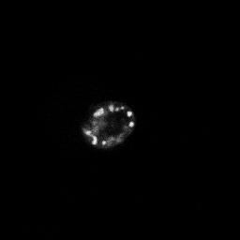
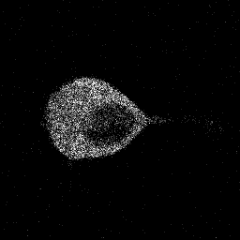
cN&B
sN&B in 2 colour mode: just as single colour fluctuations are set by protein oligomeric state, cross-colour fluctuations are set by heterologous protein binding (and co-diffusion)
Statistics in each channel independently:
- mean intensity: F^{j} =<F_{k},^{j}>_{k}
- count variance: σ_{F}^{j} =<(F_{k},^{j})²>_{k}-(F^{j})²
- channel brightness: e_{F}^{j} = σ_{F}^{j} /F^{j} -1
- green fluorophore number: n_{F}^{j} = F^{j} /e_{F}^{j} (same data for red channel C)
Statistics crossing the channels:
- Cross variance:
σ_{cc} ^{j} =<(F_{k},^{j}-F^{j})*(C_{k},^{j}-C^{j}) >_{k}
_{- Cross brightness:}
B_{cc} ^{j} =σ_{cc} ^{j} /F^{j}*C^{j}
Laser excitation
GFP photon counts at pixel j and scan # k: F_{k},^{j}
GFP
Protein 1
mCherry
Protein 2
mCherry counts at pixel j and scan #k: C_{k},^{j}
Proteins 1&2 simply colocalize: σ_{cc} ^{j} ≈ 0; 1&2 avoid each other: σ_{cc} ^{j} < 0
Proteins 1&2 co-diffuse (interact): σ_{cc} ^{j} > 0
Fraction of bound proteins: quantified by Bcc; need calibration to extract
K_{d} from Bcc, e_{F} and e_{C}

Slide 27
Supp. Slide #3: Quantify protein synthesis and/or diffusion with FRAP-FLIM
Notes:
- quantitative imaging and mathematical modeling complement high throughput

Slide 28
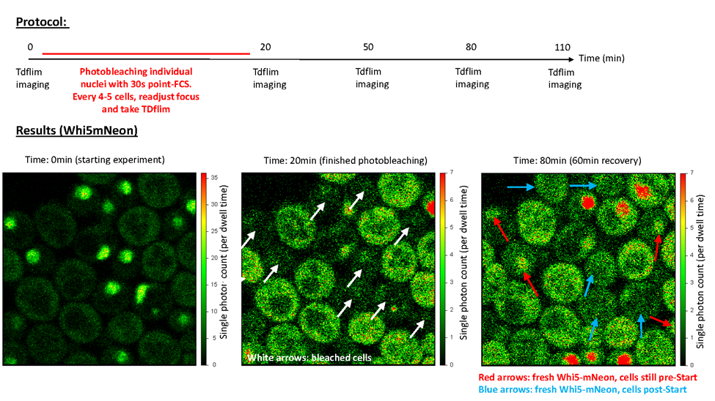
An application: monitor protein synthesis or motion with FRAP-FLIM
Field of View (FOV) | Lifetime before photo-bleaching (ns) | Lifetime after 60 min recovery (ns)
Whi5mNG FOV1 | 2.920 | 2.771
Whi5mNG FOV2 | 2.922 | 2.796
Whi5mNG FOV3 | 2.952 | 2.779
Whi5mNG FOV4 | 2.892 | 2.758
Whi5mNG FOV5 | 2.903 | 2.864
pGAL1-mNG | 2.919
Auto-fluorescence (free NADH) | Typically 1.5
Auto-fluo. (bound NADH) | Typically 6-7
From Litsios et al., submitted to MBoC

